Slide 1
Sprint 1 - Image Search
By Siyuan Zhang, Tianhao Yao, Shu Yang
03.Oct.2022

Slide 2
Project mission
Allows a user to search for images using an image as the starting point.
You simply upload an image, or provide a link to an image that can be found online, and the service will try to find related images.

Slide 3
User profile
Everybody can be a user of reverse image searching as long as he wants to learn more about the information of a particular picture.
Researcher
Police
Photographer

Slide 4
Literature review
"Reverse image search for scientific data within and beyond the visible spectrum“
"Large scale reverse image search“
“An Evaluation of reverse Image search performance of Google"

Slide 5
User story
Sprint 1
I am not an expert in searching information,
I need you to guide me and tell me where I can find what I want
No problem!
We can provide blogs along with the information. You will see and join the discussion.
We can provide advised questions. If you don’t want to go through blogs, we have remembered previous searching route of the user who has similar questions. May they be your enlightment.
Key word:blogs, searching route

Slide 6
User story
Sprint 1
It’s my first time surf the internet,
I don’t know how to ask you question using your style, I will just type some noun, I need you to fill the sentense for me
No problem!
We will use the NLP combined with deep learning to generate what most people will ask about that related to your noun.
key word: NLP, deep learning

Slide 7
User story
Sprint 1
I am tired of restless advertising calls and spam letters,
I need you to protect my private information, I need to be invisible to the web page I browsed.
No problem!
We promise you never collect your browse history, but we will store some settings using cookie.
We will using redirection and encrypt technology to help you confuse the web page
Key word: information collection, redirection, encrypt

Slide 8
User story
Sprint 1
I am a student / researcher, I want to find some real fruitful and professional informations using your searching engine.
No problem!
We will using a lot of crawlers to visit a lot of professional websites and provide you
Key word: crawler

Slide 9
MVP User story
Sprint 1
Taking the intersection of the needs of the customers
We need crawlers visits with a direction: we should at least build databases preserving documents about blogs, acdemic materials, latest news & events
We need a very good algorithm to protect the customer’s private information
We not only need to optimize customer questions, but also need to provide relevant questions to the customer.

Slide 10
Technologies to evaluate
Sprint 1
Precision and Recall.
Precision: related documents / all return results
Recall: returned related documents / all documents
P@10 index
Focus on the searching quality of top 10 results
P@10 = related documents / 10 * 100%

Slide 11
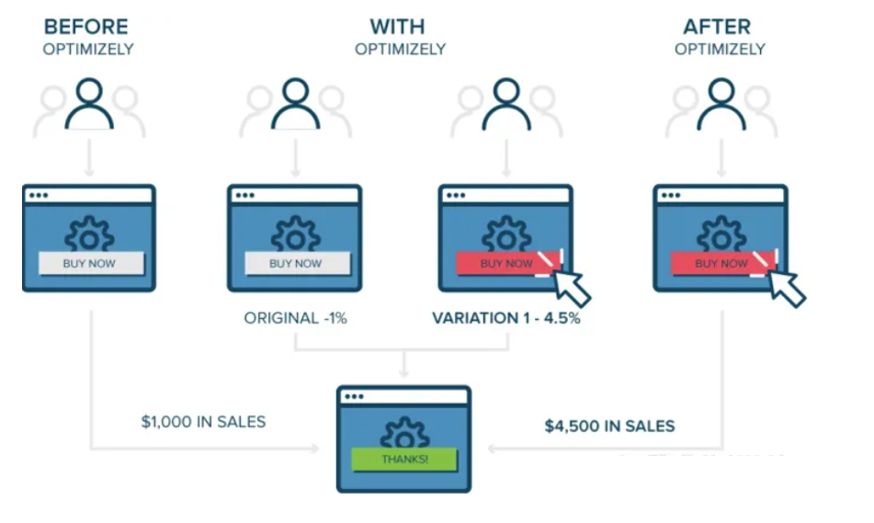
Technologies to evaluate
Sprint 1
A/B testing
System decides the bucket id for each user
Different bucket id will use different searching system to find results
Weekly/Monthly check to see which bucket has better sales

Slide 12

Development environment
Sprint 1
Lucene
Open source full-text search engine frame
Java based
Widely used by search engine technology like Elastic Search and Solr

Slide 13
Next Sprint
Sprint 1
Continue to learn Lucene
Write a small demo

